Slide 1
Visualization Ethics
HUGEN 2073
Genomic Data Visualization & Integration
Adapted from Ryan L. Minster, PhD, MSIS with permission

Slide 2
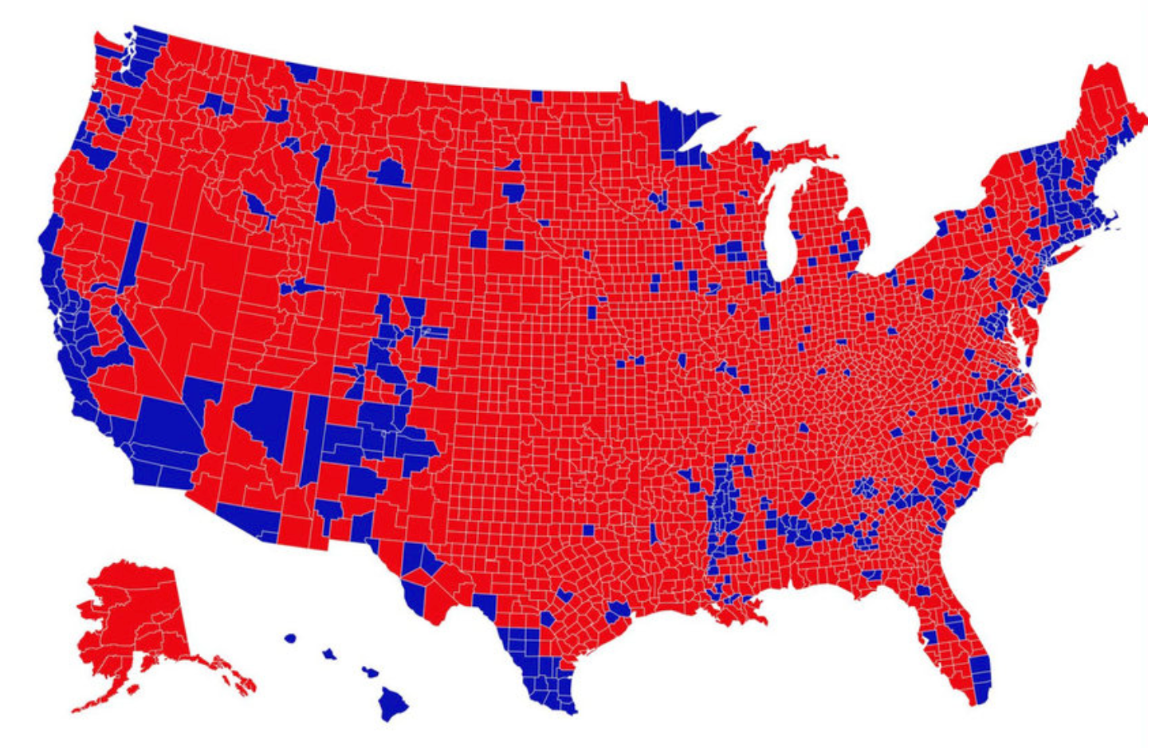
Visualization Ethics
HUGEN 2073
Genomic Data Visualization & Integration
Ryan L. Minster, PhD, MSIS
March 4, 2021

Slide 3
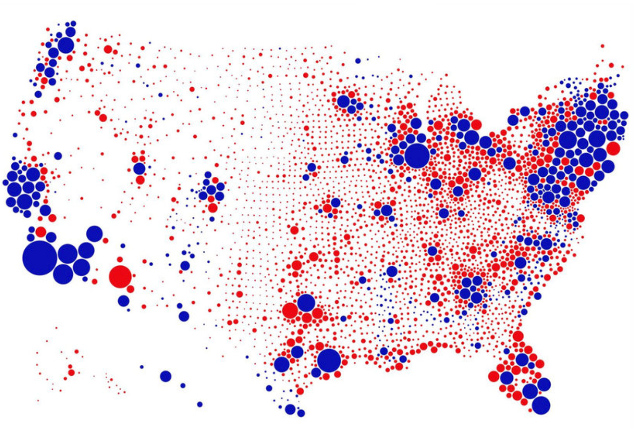

Slide 4
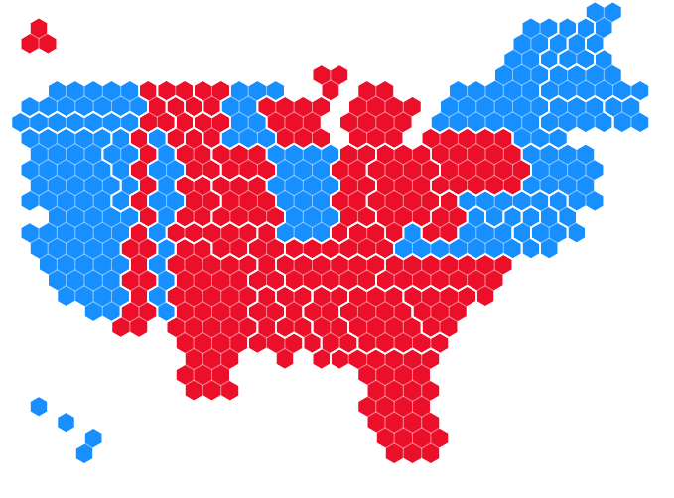

Slide 5
Learning Objectives
By the end of the session, students will be able to:
Describe common ways that visualizations can mislead
Employ strategies to prevent the use of visualizations that mislead
Use basic techniques that enhance the accessibility of visualizations
Describe how visualizations can be designed to be more equitable and inclusive

Slide 6
Ethics
Veracity truth, accuracy
Fidelity integrity in relationships, keeping promises
Autonomy self-agency, ability to make decisions for oneself
Justice fairness, equity, non-discrimination, transparency
Nonmaleficence avoid harm
Beneficence do good

Slide 7
Good charts that are correctly read enable conversations. Bad charts—or charts that misinterpreted—hinder those conversations.
Alberto Cairo
How Charts Lie

Slide 8
Visualizations as a Conversation
Explanation
Persuasion

Slide 9
Common Ways that Visualizations Mislead
Fabrication

Slide 10
Common Ways that Visualizations Mislead
Fabrication
Omission
Deletion of inconvenient points
Deletion of extreme values
Smoothing
Aggregation

Slide 11
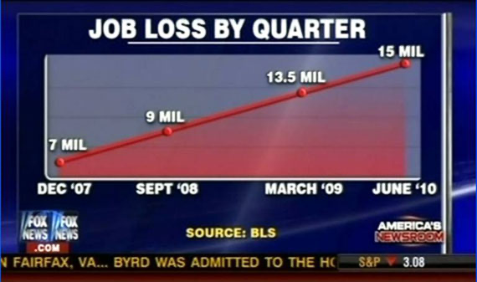
Media Matters for America
Notes:
https://web.archive.org/web/20200106112844/https://www.mediamatters.org/fox-news/updated-worst-chart-ive-seen-all-day

Slide 12
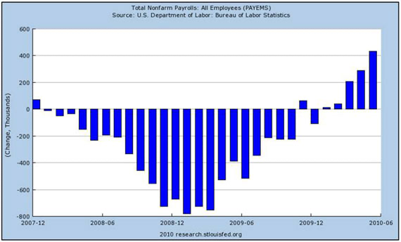
Media Matters for America

Slide 13
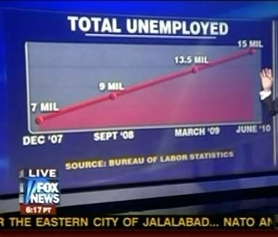
Media Matters for America

Slide 14
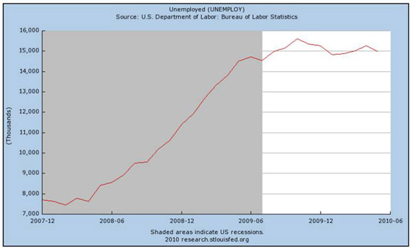
Media Matters for America

Slide 15
Common Ways that Visualizations Mislead
Fabrication
Omission
Framing
Scaling (lineic vs areic vs volumic comparisons)
Truncating axes / omitting the baseline / axis ratios
Missing context / denominator problems
Going against convention

Slide 16
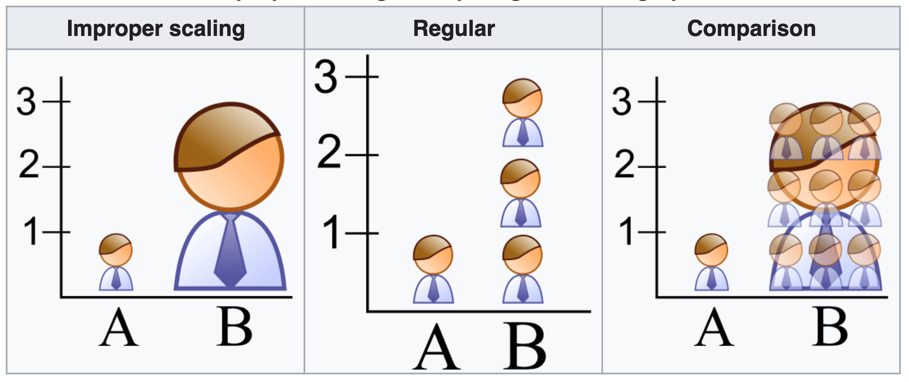

Slide 18
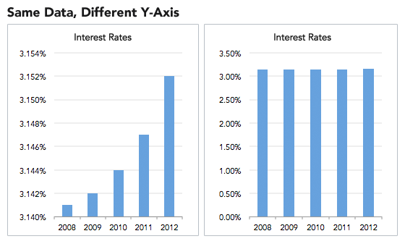

Slide 19
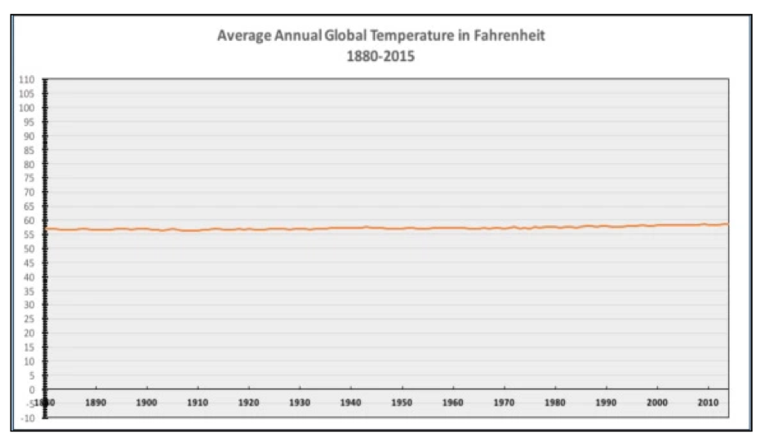
https://venngage.com/blog/misleading-graphs/

Slide 20
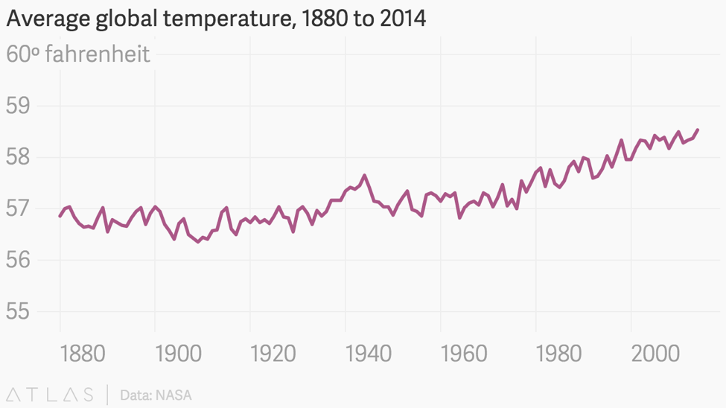
https://venngage.com/blog/misleading-graphs/

Slide 21
Media Matters for America
Notes:
Should say “total unemployed”!
And the data were cherrypicked from various quarters.

Slide 22
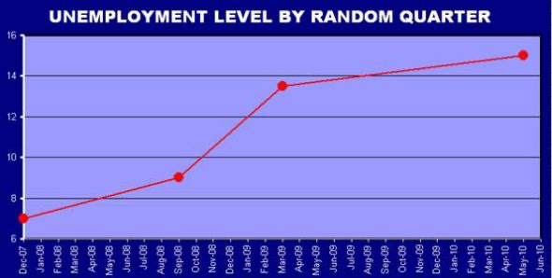
Media Matters for America
Notes:
Corrected version of previous graph

Slide 23
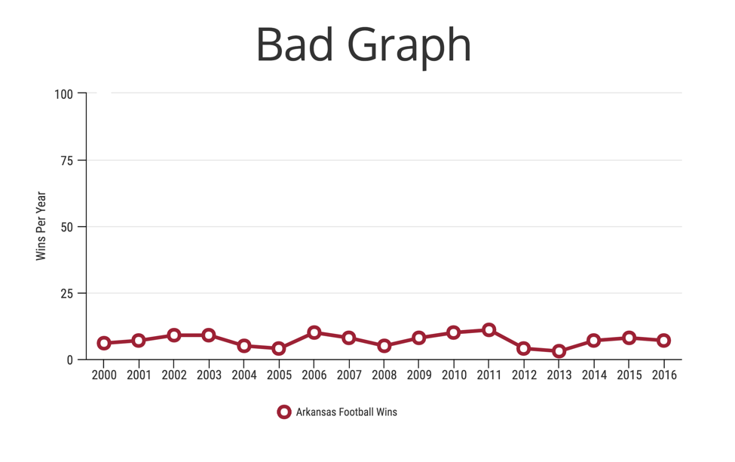
https://venngage.com/blog/misleading-graphs/

Slide 24
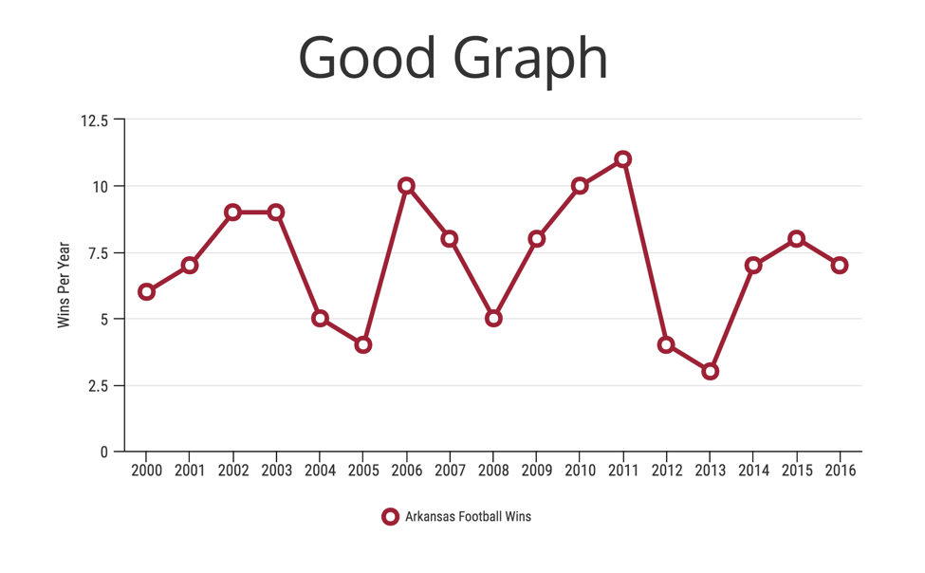
https://venngage.com/blog/misleading-graphs/

Slide 25
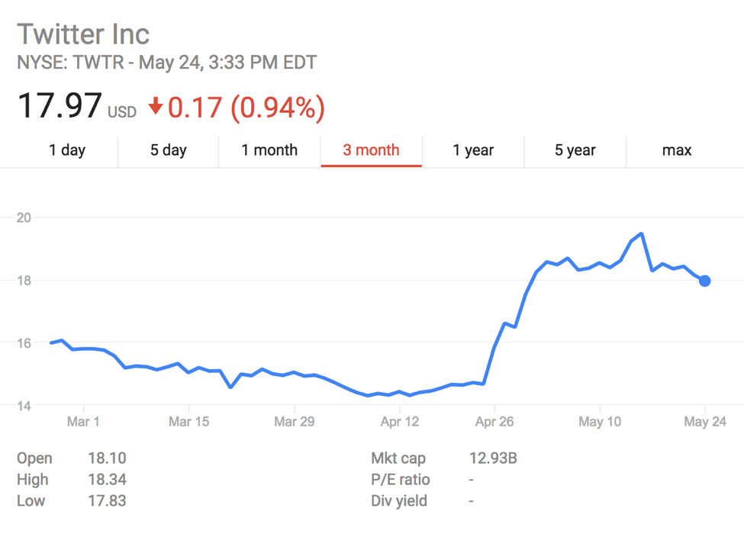
https://venngage.com/blog/misleading-graphs/

Slide 26
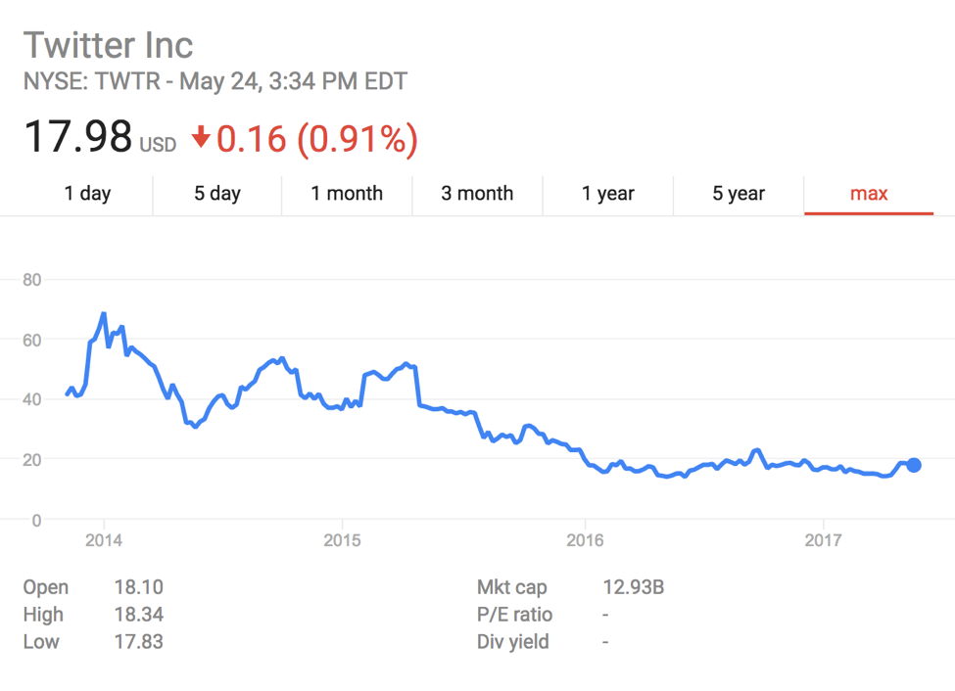
https://venngage.com/blog/misleading-graphs/

Slide 27
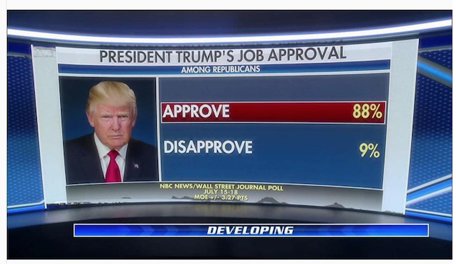
https://venngage.com/blog/misleading-graphs/

Slide 28
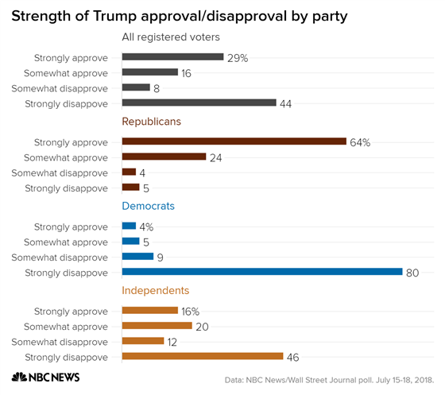
https://venngage.com/blog/misleading-graphs/

Slide 29
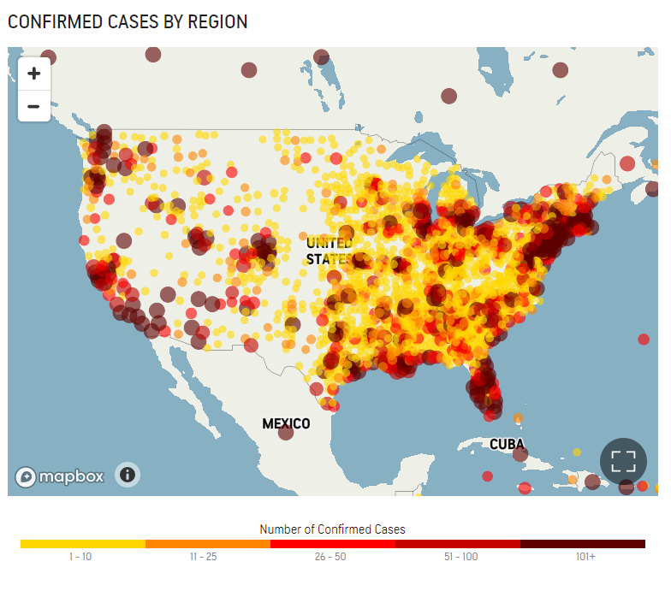
https://venngage.com/blog/misleading-graphs/

Slide 30
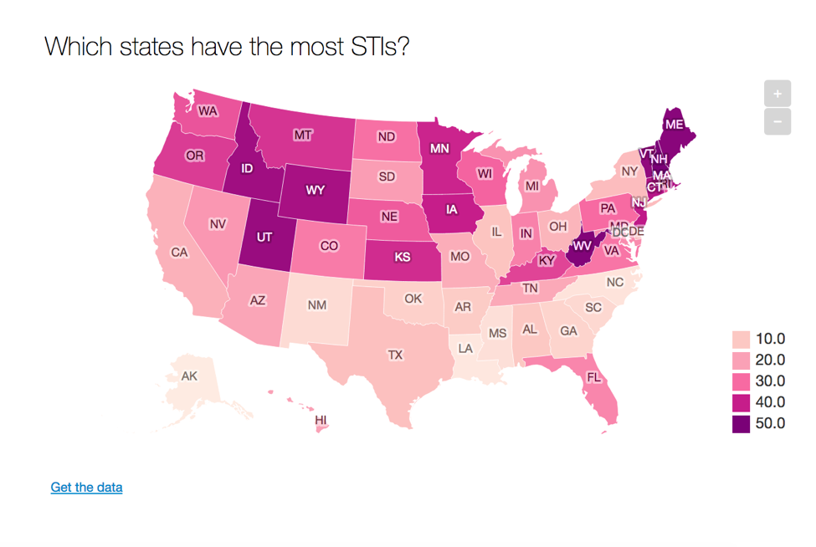
https://venngage.com/blog/misleading-graphs/
Notes:
“Each state has been rated from one to 50: the higher the score, the smaller the proportion of STIs. So on the map - the darker the colour, the smaller the rate of STIs.”

Slide 31

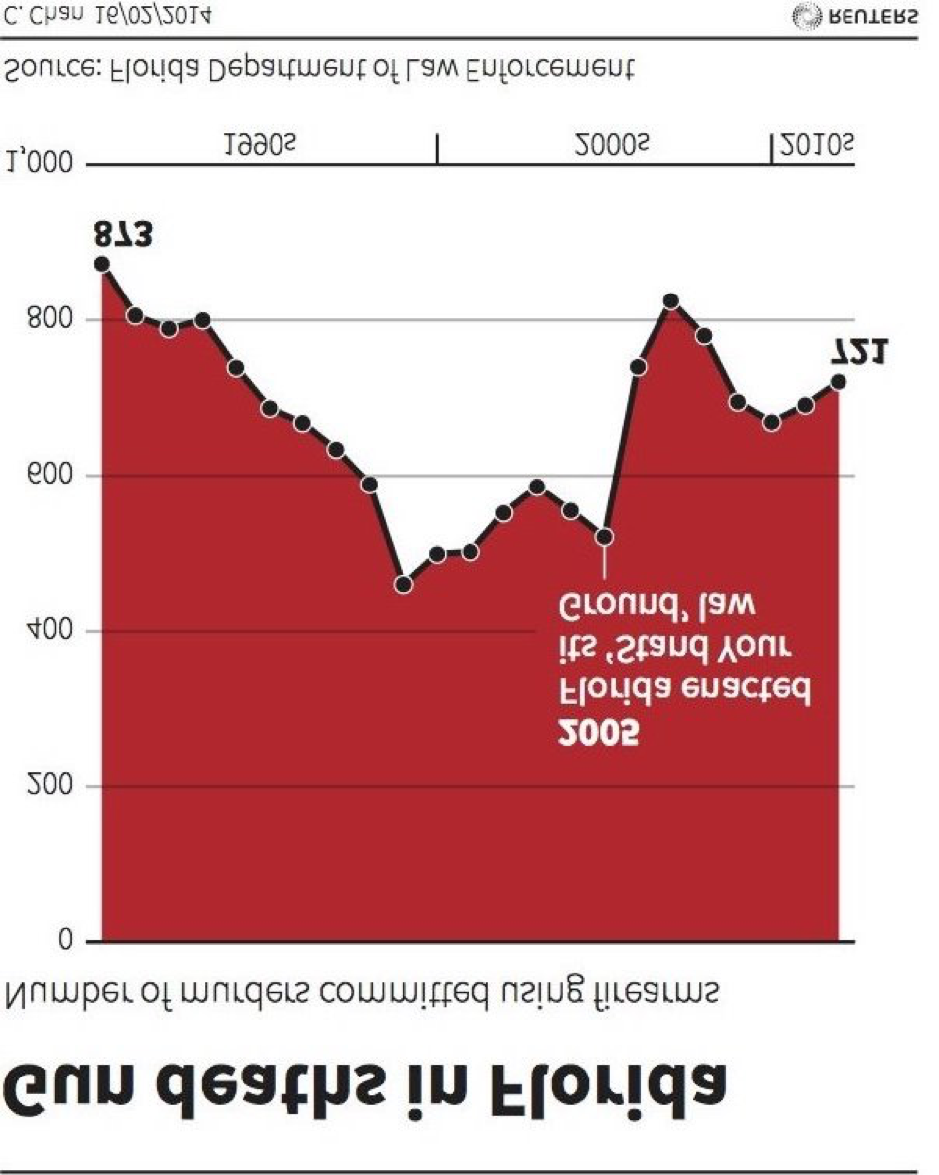
https://venngage.com/blog/misleading-graphs/

Slide 32
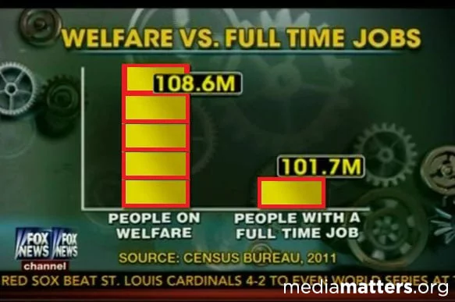
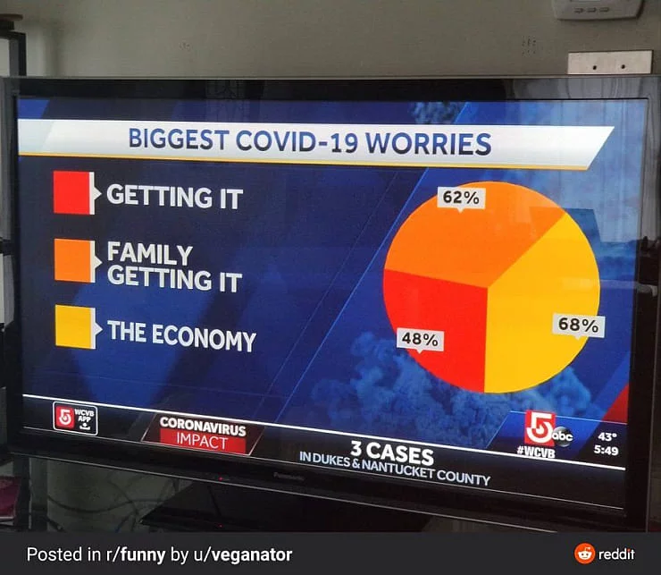
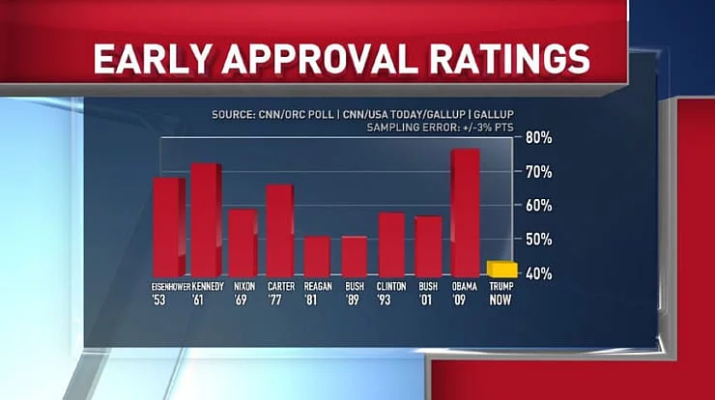
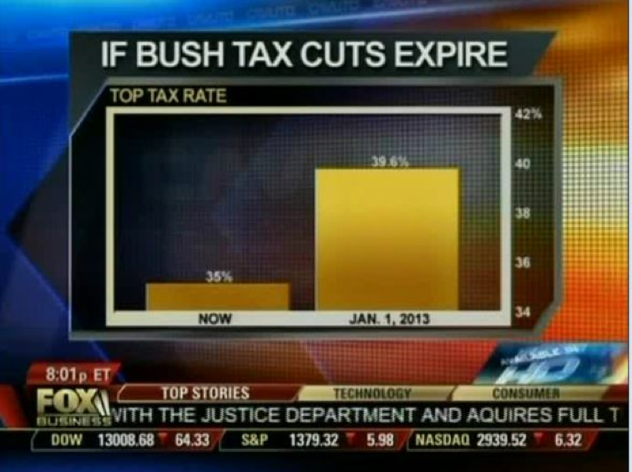
Notes:
Examples from https://viborc.com/ethics-and-ethical-data-visualization-a-complete-guide/

Slide 33
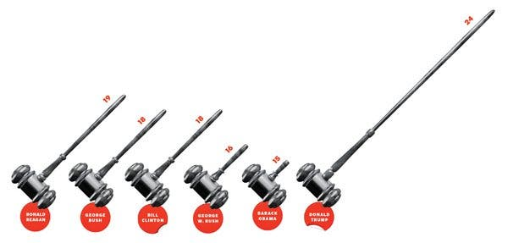
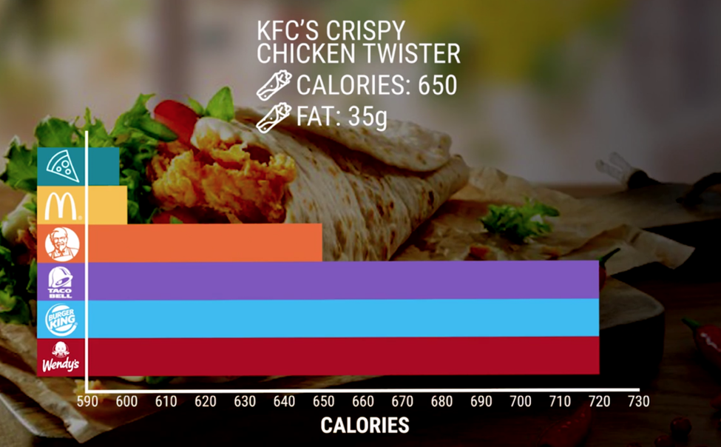
Notes:
Sources: New York Times and https://venngage.com/blog/misleading-graphs/

Slide 34
How to avoid misleading visualizations
Be conscious of your choices (hopefully this class helps with that)
Have conversations with your team about how the visualization is explaining or persuading
Run visualizations by non-specialists and non-insiders:
What is their take-away?
Are you unintentionally misleading?
Run a visualization by someone for only 5 seconds:
What is their take-away?
Are you unintentionally misleading?

Slide 35
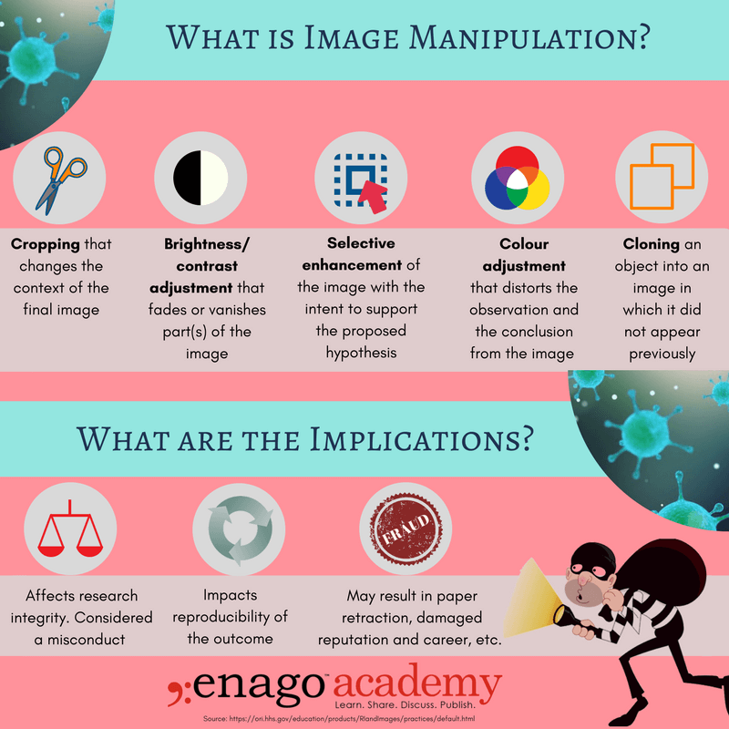
Manipulation of Images/Photographs
Image Integrity & Standards
https://www.nature.com/nature-portfolio/editorial-policies/image-integrity
Specify equipment and acquisition software
Deposit raw images with submission
Processing software should be named, and manipulations should be enumerated

Slide 36
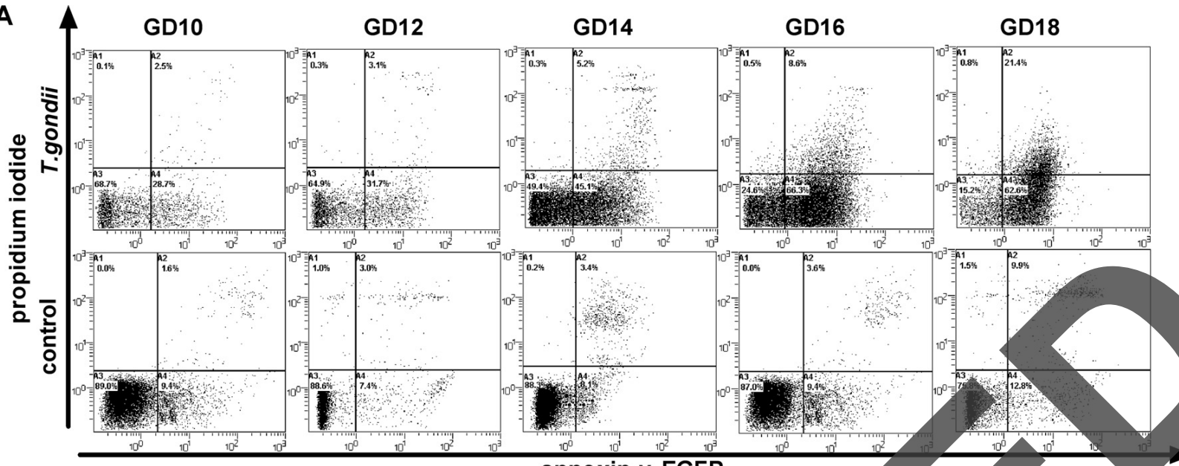
3.8% of Publications have Problematic Figures
Bik et al. mBio. 2016
Xu et al. Infect Immun. 2012 (Retracted)

Slide 37
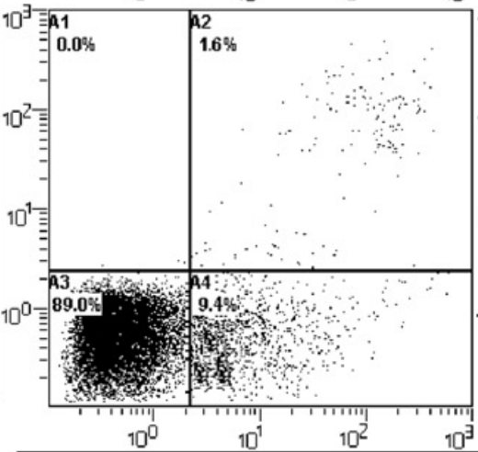
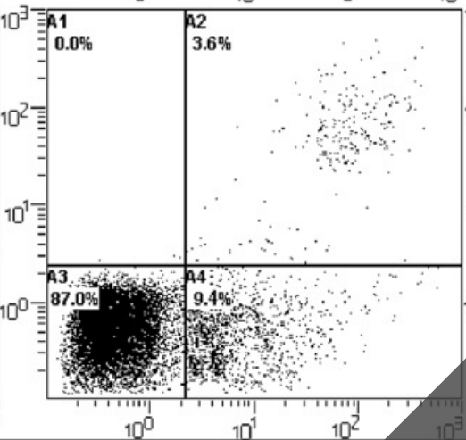
3.8% of Publications have Problematic Figures
Bik et al. mBio. 2016
Xu et al. Infect Immun. 2012 (Retracted)

Slide 38
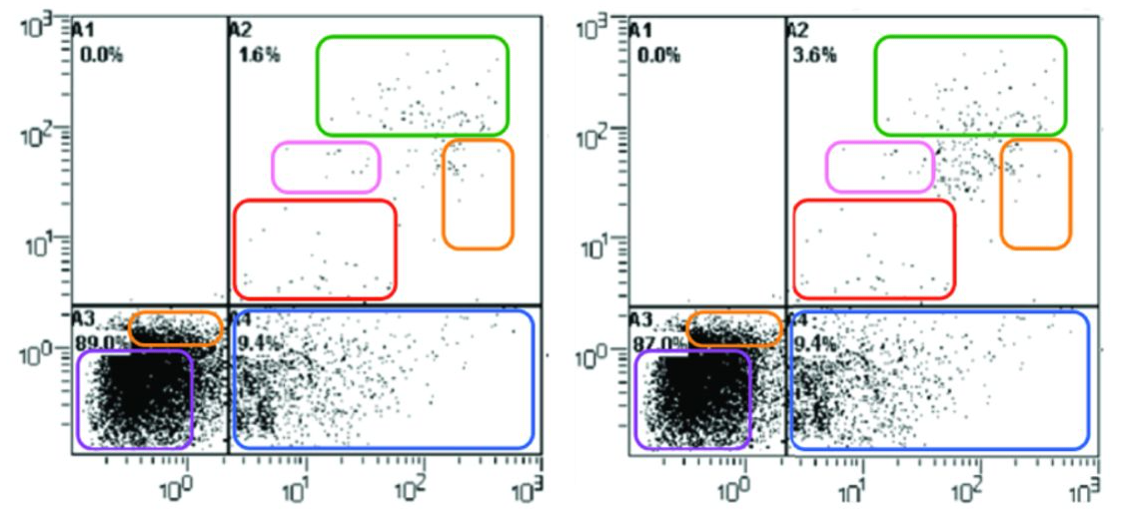
3.8% of Publications have Problematic Figures
Bik et al. mBio. 2016

Slide 39
Accessibility

Slide 40
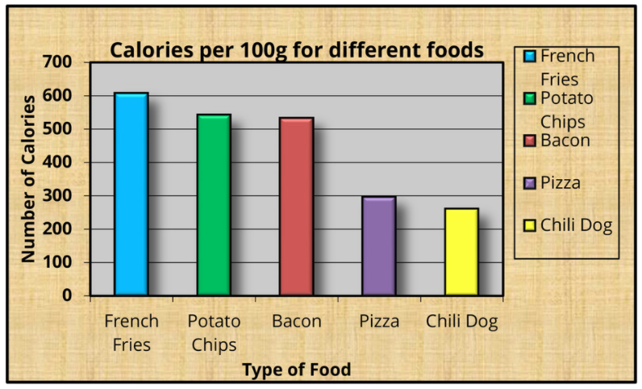
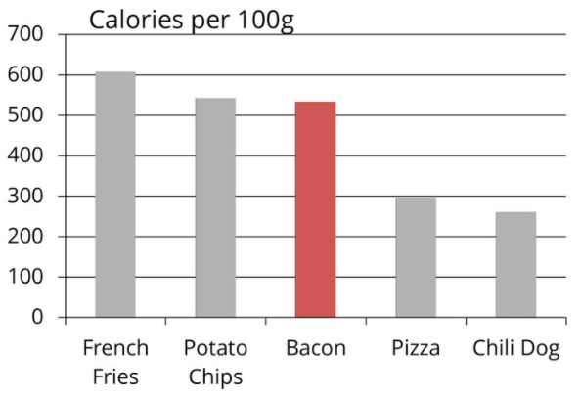
Accessibility
In general, principles such as good data–ink ratios also inherently make images more accessible to individuals with visual impairments—both minimal and profound impairments

Slide 41
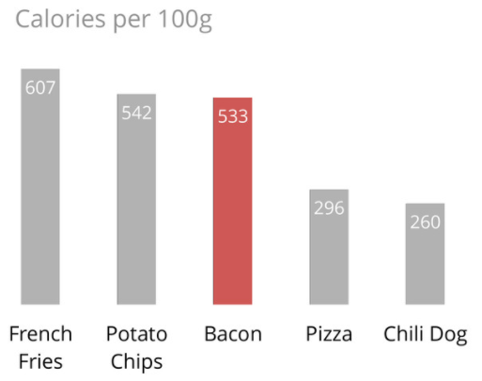
Accessibility
But maybe not this:

Slide 42
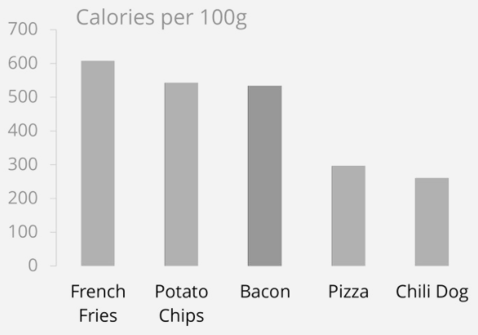
Accessibility
Perhaps?
607
542
533
296
260

Slide 43
Accessibility
Add good alt text
Example guidelines and tools for training: diagramcenter.org
Use a good title
Don’t: Risk of type 2 diabetes vs BMI
Do: Risk of type 2 diabetes is higher at higher BMI
Figure captions (beyond the title) and alt text should complement each other. Captions often describe how to interpret the figure. Alt text describes the figure itself.

Slide 44
Accessibility
Add alt text
Use a good title
Label data directly

Slide 45
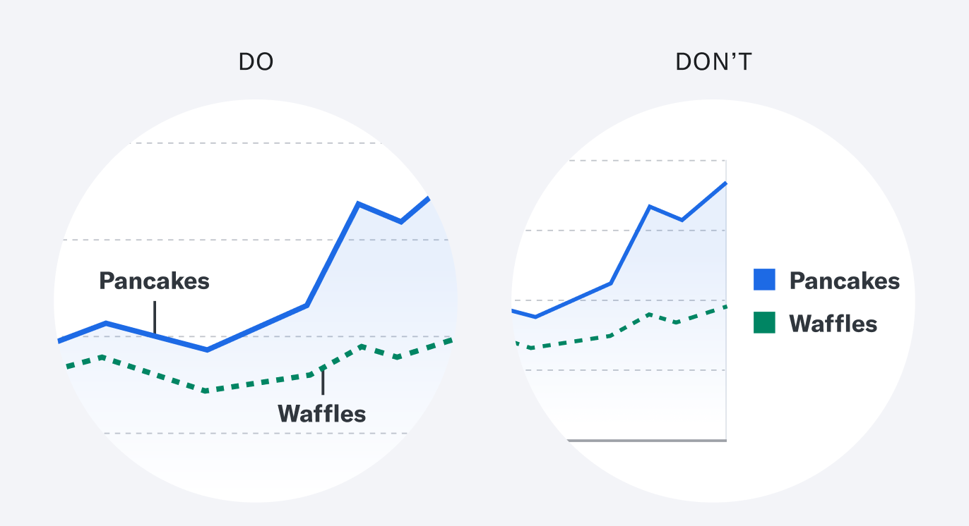

Slide 46
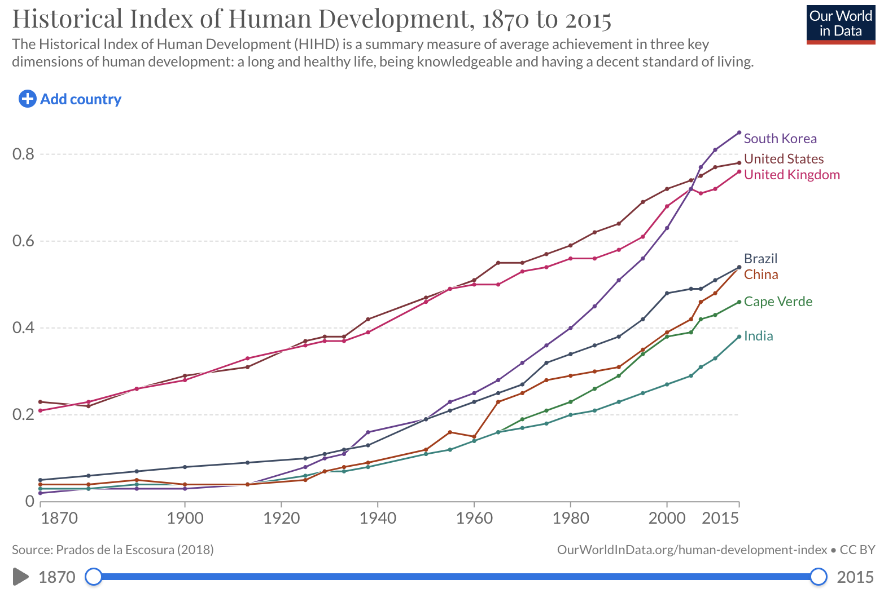

Slide 47
Accessibility
Add alt text
Use a good title
Label data directly
Employ effective color contrast
colorsafe.co
colorbrewer2.org
Colorblinding Chrome extension

Slide 48
Accessibility
Add alt text
Use a good title
Label data directly
Employ effective color contrast
Use whitespace effectively

Slide 49
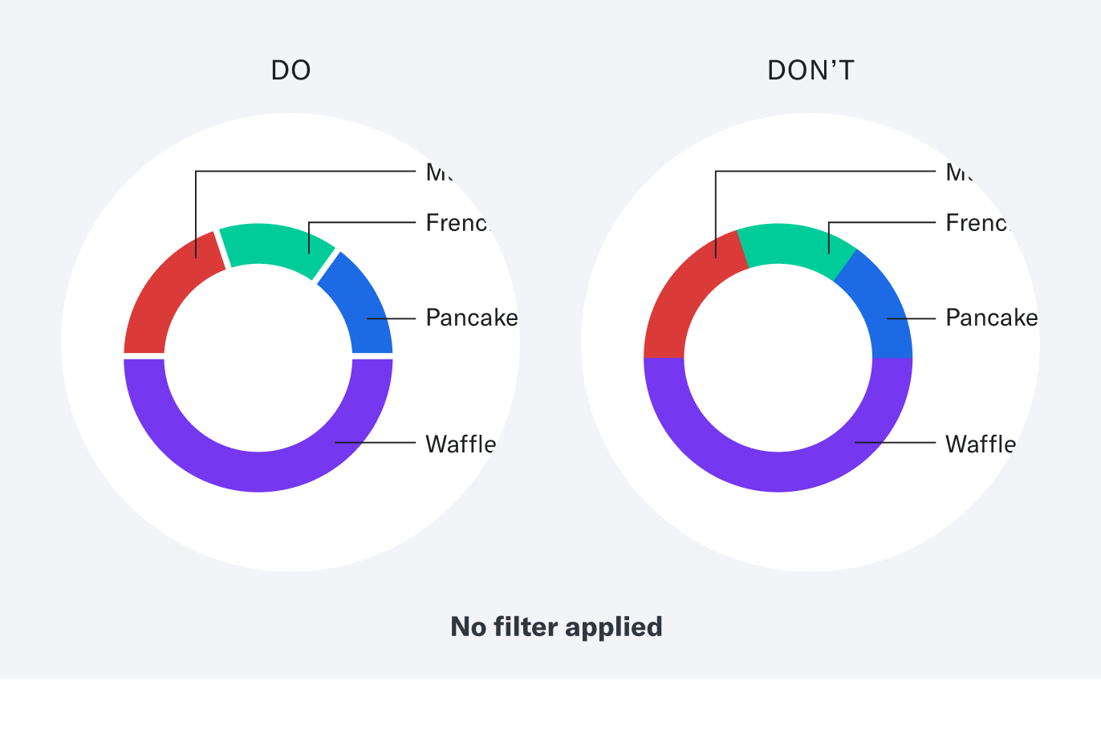

Slide 50
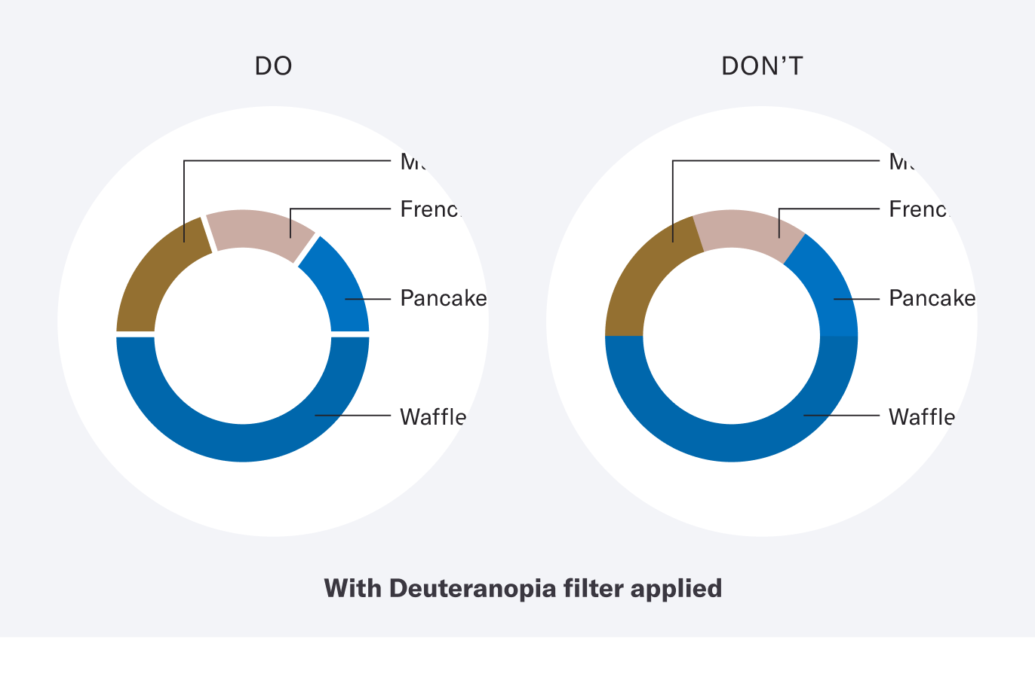

Slide 51
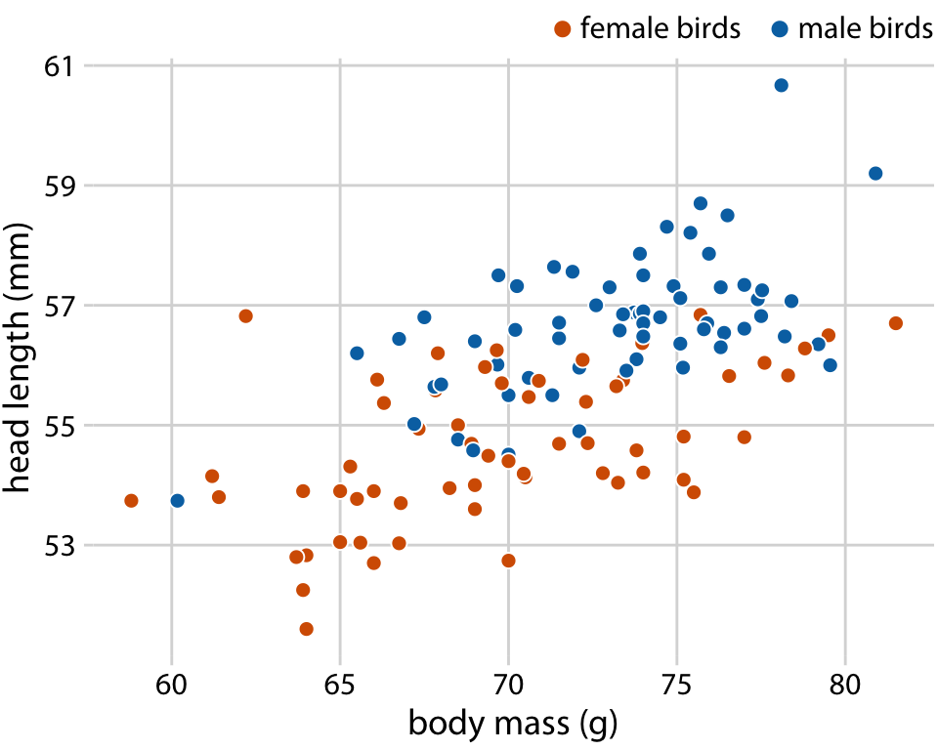
Wilke. Fundamentals of Data Visualization. 2020

Slide 52
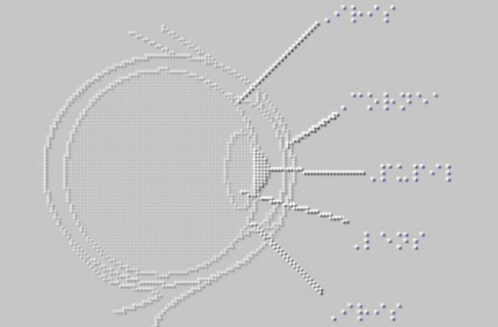
Think about How Your Visualization Might Convert to a Tactile Graphic

Slide 53

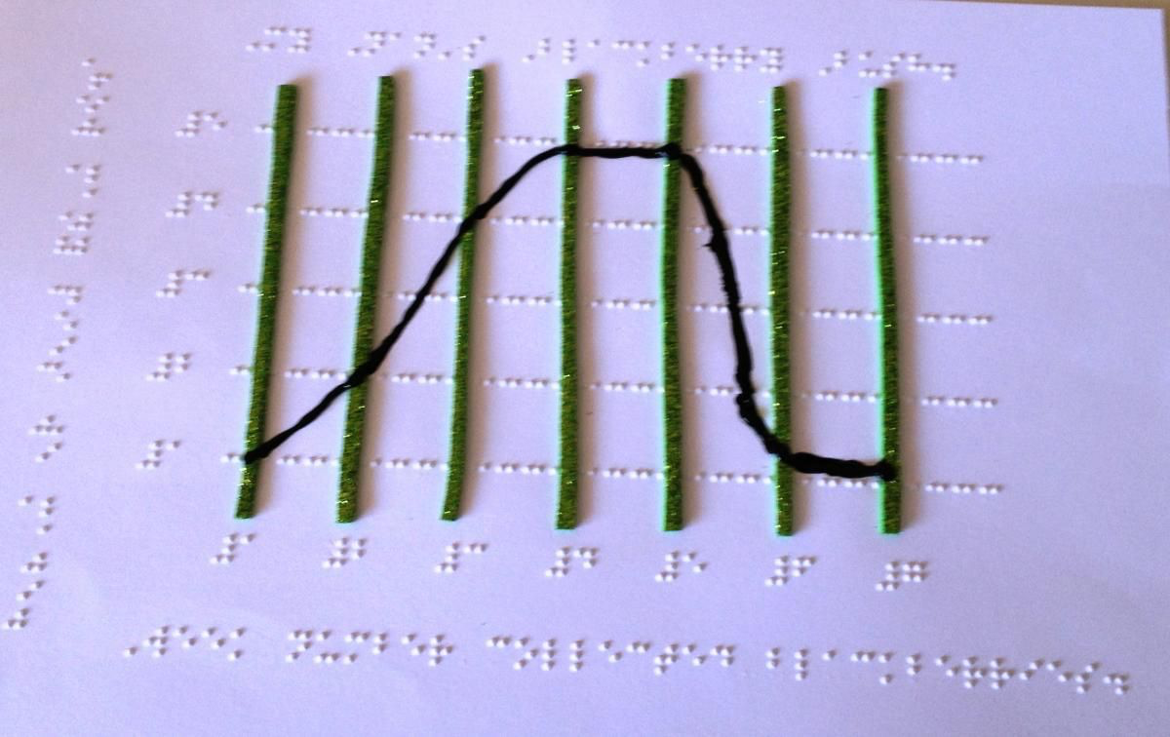

Slide 54
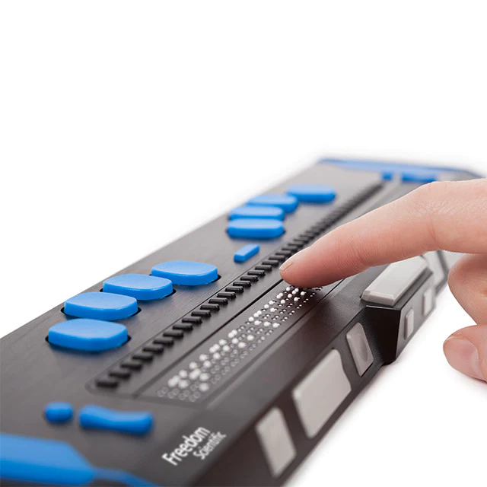
Accessibility
For blind individuals in your audience, good alt text and a good title and caption will often serve best because the most common assistive technology will be a screen reader.
A refreshable brail display enables blind readers to read without being read to.

Slide 55
Justice, Equity, Diversity and Inclusion

Slide 56
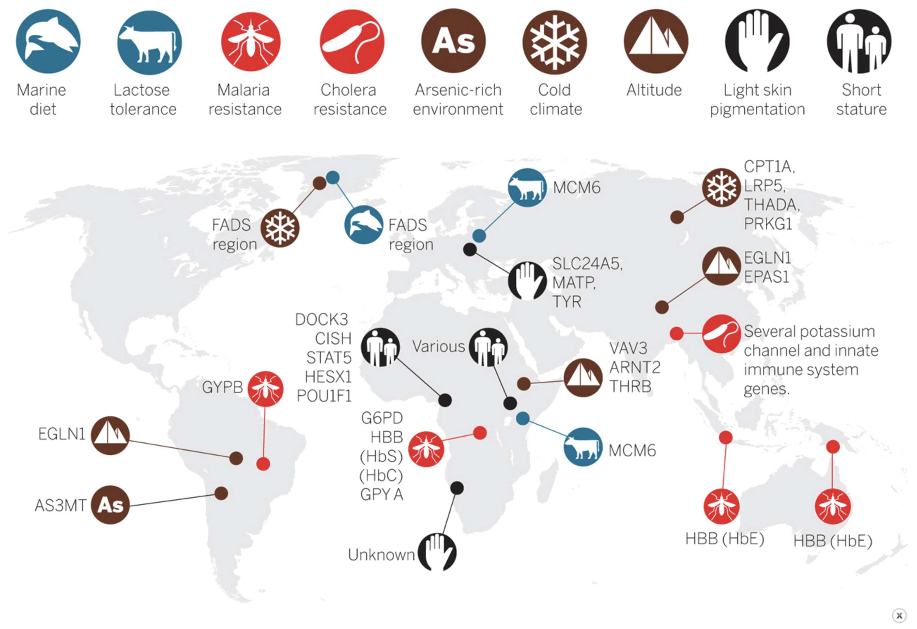
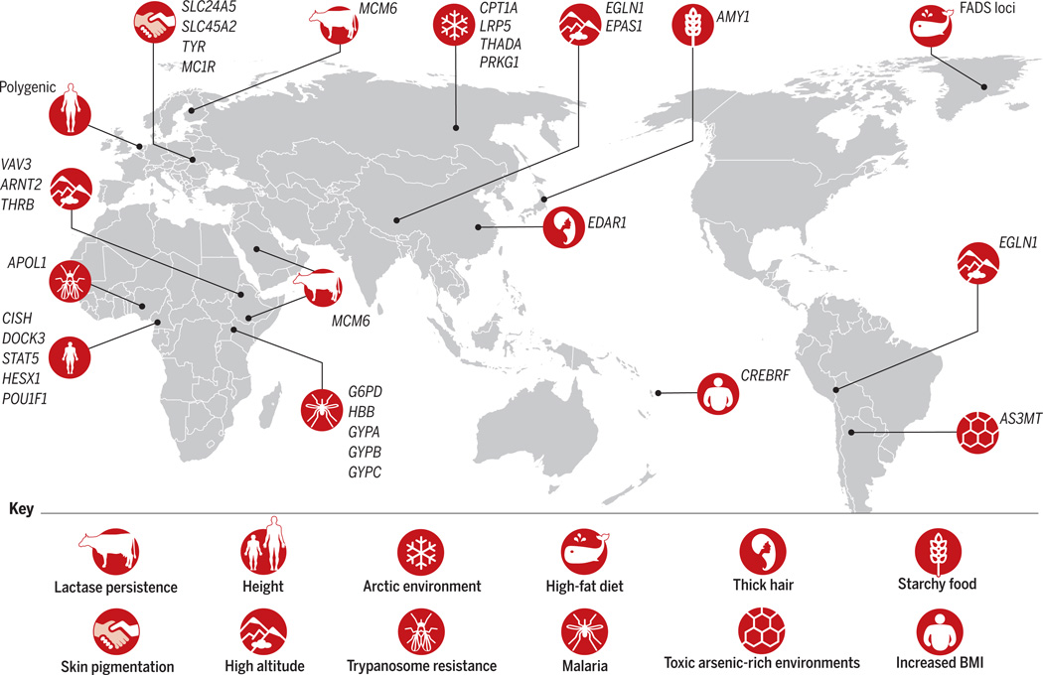
2,204 mi
7,113 mi
CREBRF
Fan et al. Science 2016
Tishkoff. Science 2015

Slide 57
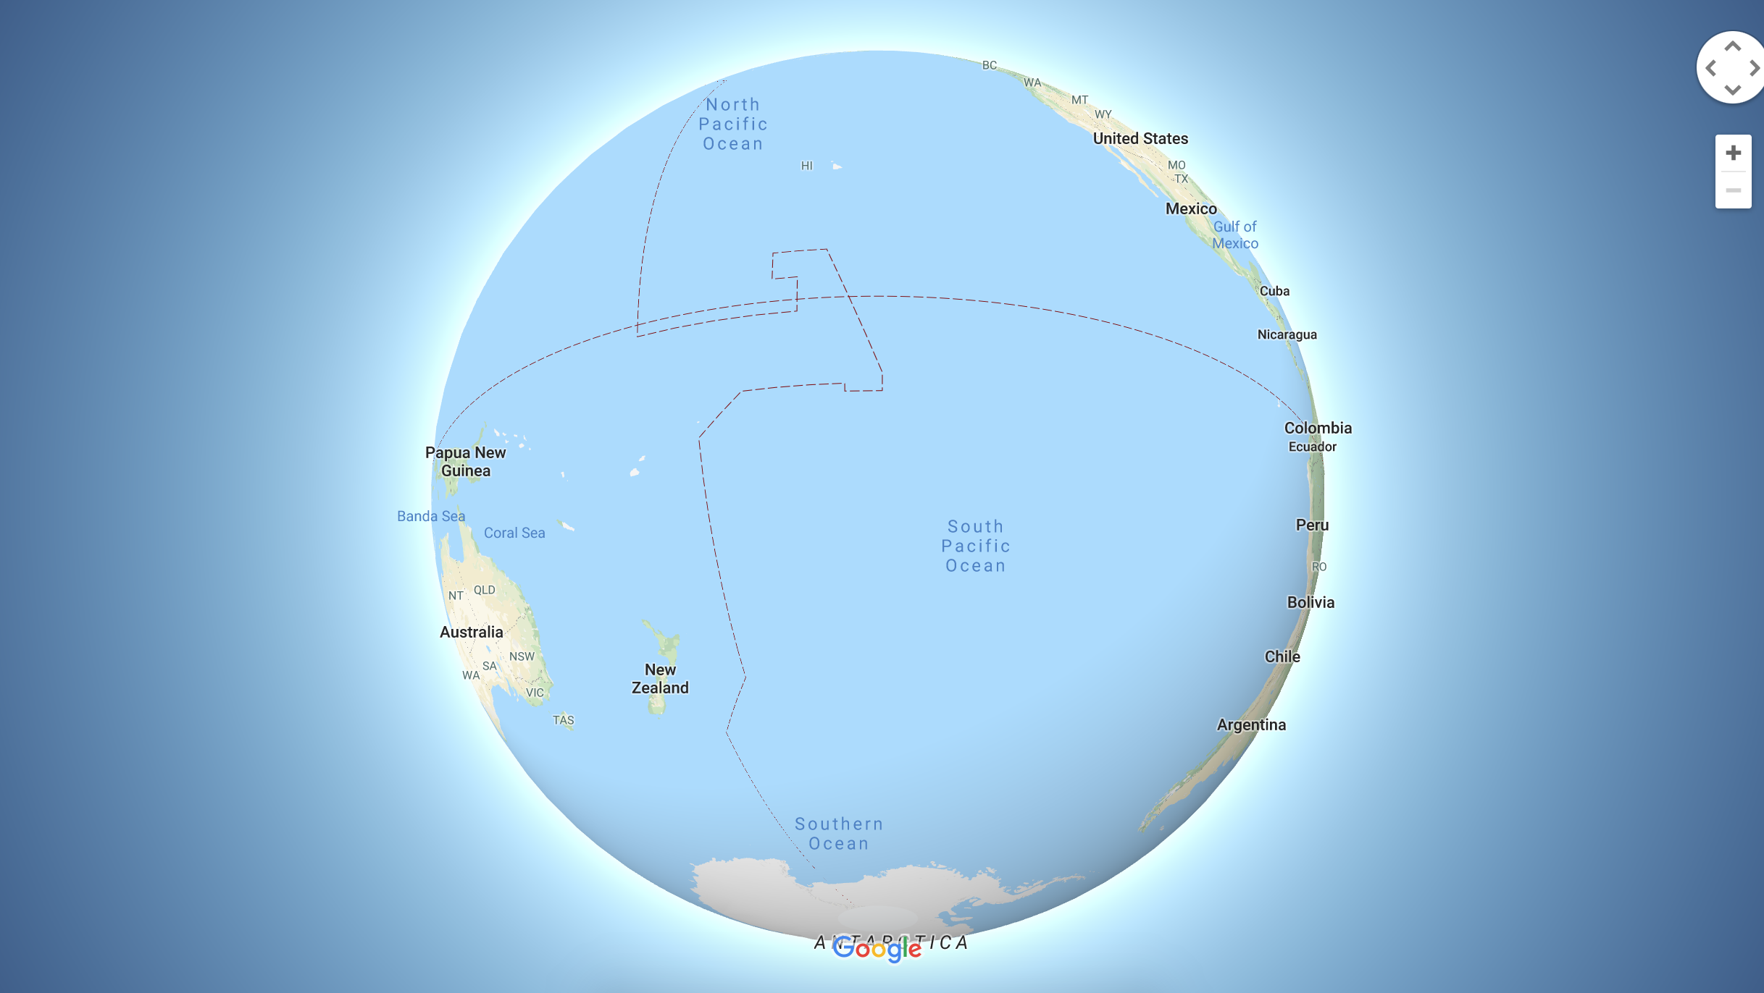

Slide 58
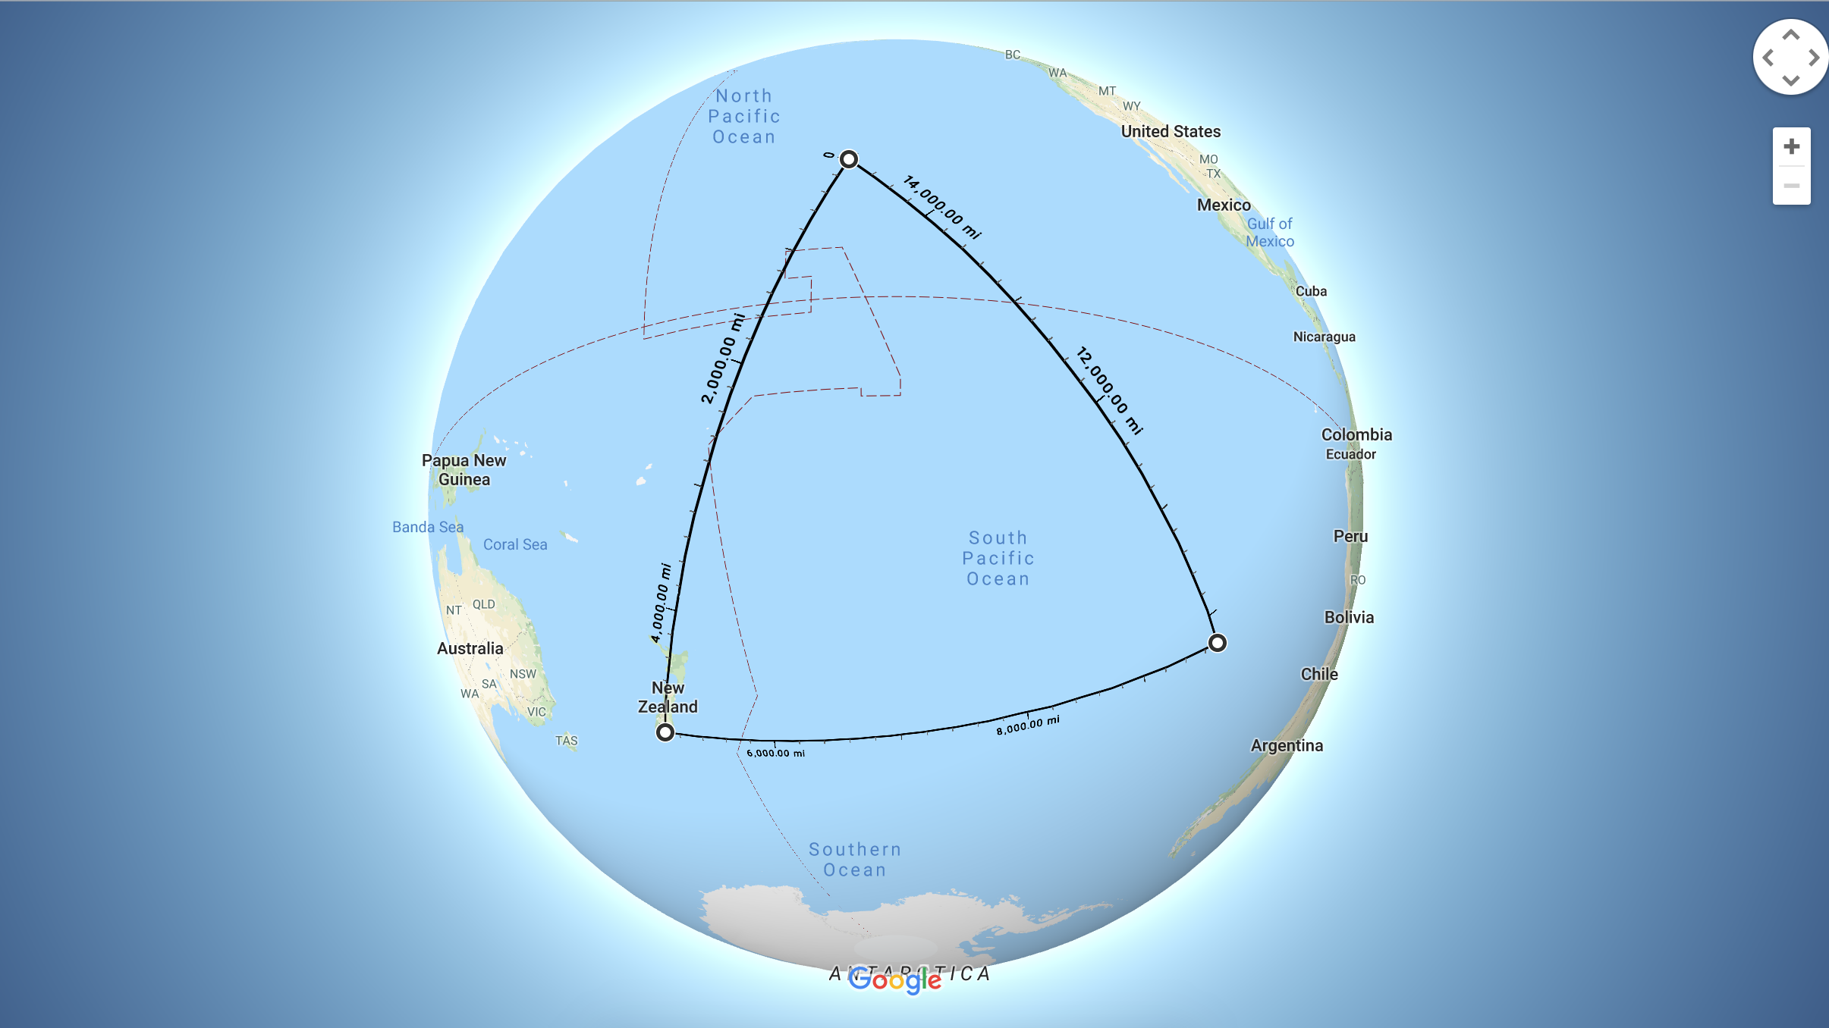
Hawai‘i
Samoa
Tahiti
Aotearoa
Rapa Nui

Slide 59
Justice, Equity, Diversity and Inclusion
Use language that is accessible and inclusive
Person-first language: people with disabilities vs disabled people
Some communities prefer identity-first language, such as the blind and deaf communities
Generally, use racial and ethnic categories as adjectives and not as nouns: Hispanic participants, not Hispanics
Communicate with your audience … What is their terminology for themselves?
A helpful guideline: Flanagin et al. JAMA 2021↗︎
The language will change as everyone’s understanding of themselves and each other change

Slide 60
Justice, Equity, Diversity and Inclusion
Use language that is accessible and inclusive
Order labels intentionally
Are you always putting ”White” or “Men” first?
If your study is focused on a community, put that community first
Is the order consistent with your story or argument?
Is there a quantitative variable that serves to naturally order the groups? Alphabetically, population size, sample size, effect size?

Slide 61
Justice, Equity, Diversity and Inclusion
Use language that is accessible and inclusive
Order labels intentionally
Who is missing from the visualization?
Is a racial or ethnic group absent?
Are non-binary individuals absent?
Do you describe who is in the group “Other”?

Slide 62
Justice, Equity, Diversity and Inclusion
Use language that is accessible and inclusive
Order labels intentionally
Who is missing from the visualization?
Use color intentionally
Avoid Men and Women, i.e. colors that reinforce stereotypes
How does your choice of colors foreground or background particular groups?

Slide 63
MIT Diversity Dashboard June 2020
MIT Diversity Dashboard July 2020

Slide 64
Justice, Equity, Diversity and Inclusion
Use language that is accessible and inclusive
Order labels intentionally
Who is missing from the visualization?
Use color intentionally
Consider humanizing your visualizations
Can you foreground the people in your visualizations?

Slide 65


Discovery n = 3,072
with Normal Weight · 12.6 %
with Overweight · 31.9 %
with Obesity · 55.5 %
Replication n 2,103
with Normal Weight · 17.3 %
with Overweight · 34.0 %
with Obesity · 48.8 %

Slide 66
Discovery n = 3,072
< 26 kg/m² · 12.6 %
≥ 26 kg/m² & < 32 kg/m² · 31.9 %
≥ 32 kg/m² · 55.5 %
Replication n 2,103
< 26 kg/m² · 17.3 %
≥ 26 kg/m² & < 32 kg/m² · 34.0 %
≥ 32 kg/m² · 48.8 %

Slide 67
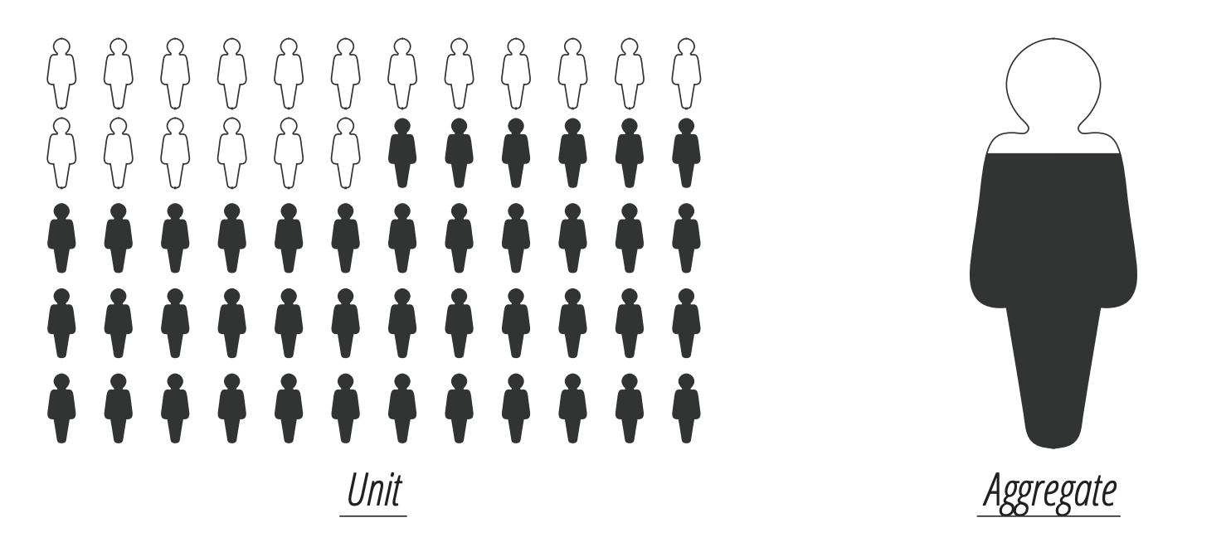
Boy et al. https://doi.org/10.1145/3025453.3025512 2017

Slide 68
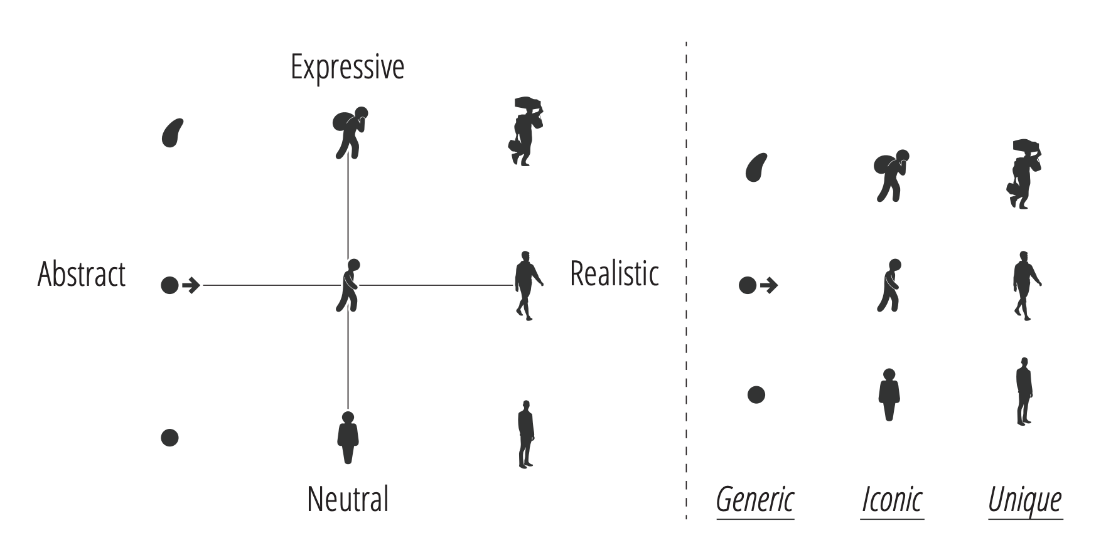
Boy et al. https://doi.org/10.1145/3025453.3025512 2017

Slide 69


Boy et al. https://doi.org/10.1145/3025453.3025512 2017

Slide 70
Justice, Equity, Diversity and Inclusion
Use language that is accessible and inclusive
Order labels intentionally
Who is missing from the visualization?
Use color intentionally
Consider humanizing your visualizations
Are you inviting unnecessary or inappropriate comparisons?
Instead of comparing groups against each other, can you compare them to an average or a target?

Slide 71

Schwabish and Feng. Urban Institute.
https://urban-institute.medium.com/applying-racial-equity-awareness-in-data-visualization-bd359bf7a7ff

Slide 72

Schwabish and Feng.
Urban Institute.

Slide 73

Blakely http://blog.pietablakely.com/presenting-data-for-a-targeted-universalist-approach

Slide 74

Blakely http://blog.pietablakely.com/presenting-data-for-a-targeted-universalist-approach

Slide 75
Ethics
Veracity truth, accuracy
Fidelity integrity in relationships, keeping promises
Autonomy self-agency, ability to make decisions for oneself
Justice fairness, equity, non-discrimination, transparency
Nonmaleficence avoid harm
Beneficence do good

